Slide 1


Smartbridge
Remote Summer Internship program
SKIN DISEASE IDENTIFICATION
USING CONVOLUTION NEURAL NETWORKS
Developed by:
G. Navya sri
K. Sai Sushma
P. Devender reddy
K. Vikram

Slide 2
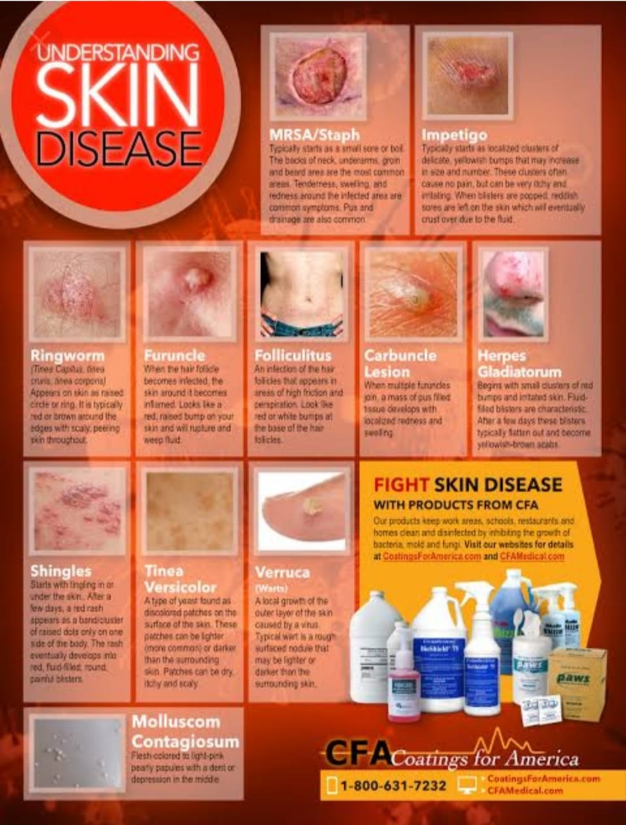
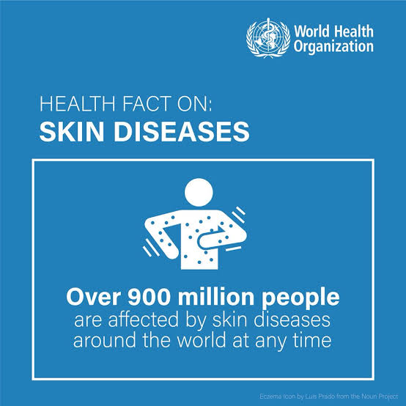
Identifying Skin Disease By Image Analysis With Deep Learning

Slide 3
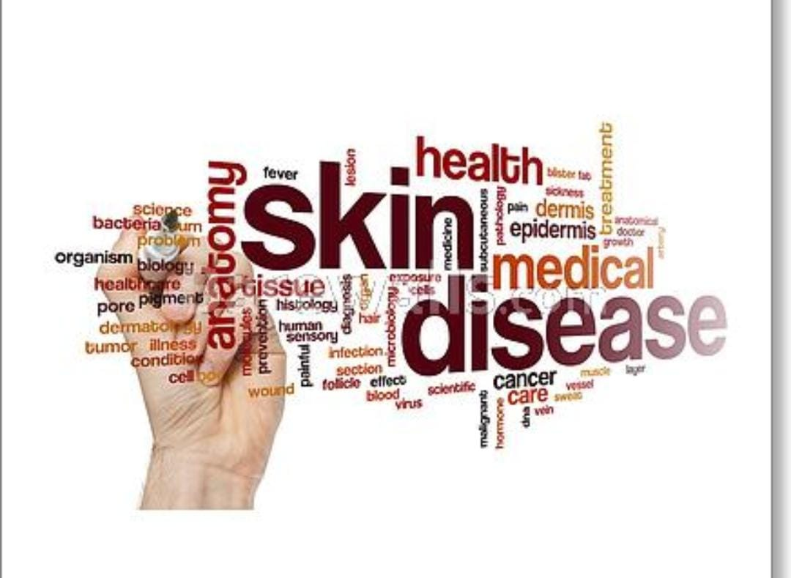
INTRODUCTION
Skin disease is one of the most common problem facing by the people nowadays.
Some skin diseases are very harmful and if it crosses the beginning stage we cannot control it. Some skin diseases are spreading, we cannot stop it after its attack .
Many of the people cannot visit hospital at beginning stage ,due to busy schedule and money problem and they may not get doctors appointment.
So we developed this project .In this project if you upload skin disease image it will predict the type of disease and outputs us, so that we can take further step.

Slide 4
Advantages:
We can know the type of skin disease, without consulting doctor.
Saves money.
Saves time.
If it is spreading disease we can take precautions before consulting doctor.
If we have natural medicine for the disease we can use it irrespective of doctors guidance.
Disadvantage:
Cannot use by uneducated people.
Sometimes it may take wrong predictions for similar type of diseases.
Need to update the images new diseases frequently.
Though we know the disease name we need to consult doctor for medicines.

Slide 5
CONCLUSION
Detection of skin diseases is a very important step to reduce death rates, disease transmission and the development of the skin disease. Clinical procedures to detect skin diseases are very expensive and time-consuming. Image processing techniques help to build automated screening system for dermatology at an initial stage. The extraction of features plays a key role in helping to classify skin diseases. In this research the method of detection was designed by using pretrained convolutional neural network (AlexNet) and SVM. In conclusion, we must not forget that this research has an effective role in the detection of skin diseases in Saudi Arabia because it has a very hot weather for the presence of deserts; this indicates that skin diseases are widespread. This research supports medical efficiency in Saudi Arabia.

Slide 6
THANKYOU

